Slide 1
Team Standards

Slide 2

Demand Total Commitment
Demand first… from yourself and then… from the others around you… total commitment is a requirement
Notes:
Lombardi

Slide 3

Weed Out The Uncommitted
Know where your strength lye
Once you learn to quit it becomes a habit
You want 100% out of everyone
If a team member doesn’t want to give look to replace them
Notes:
Lombardi

Slide 4
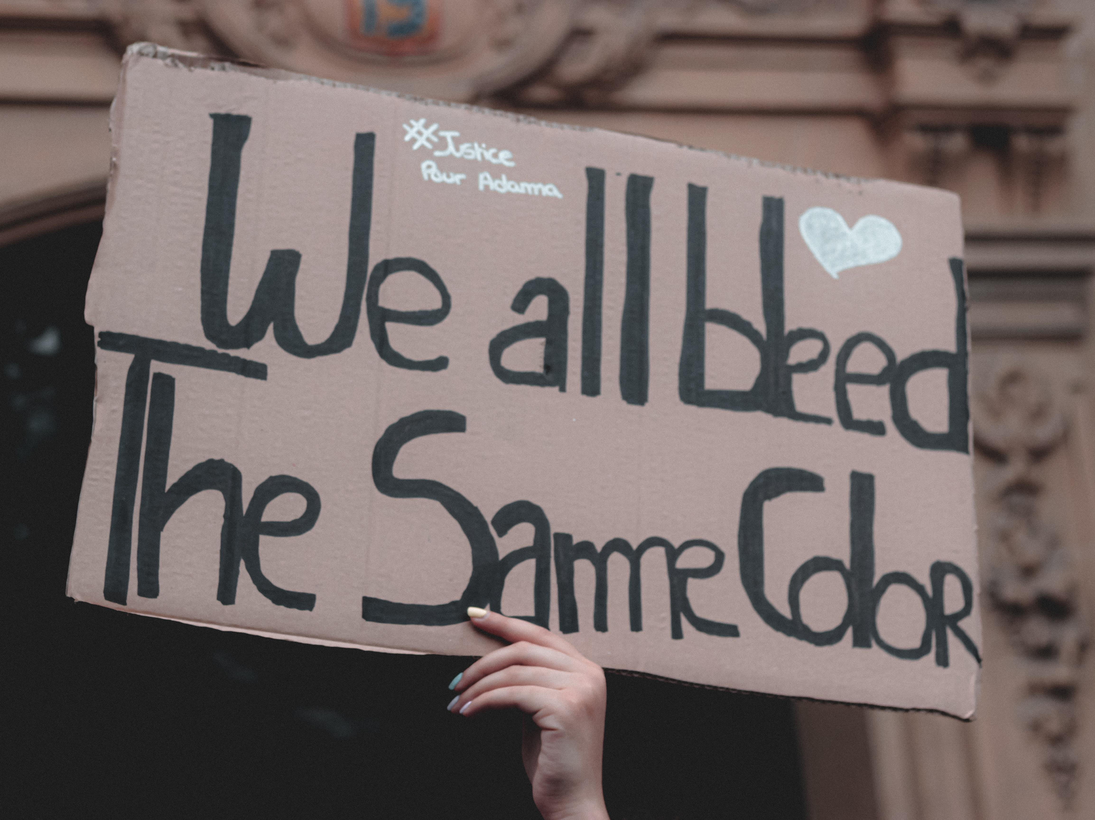
Color blindness
Everybody is respected
Search and destroy prejudice
Systemic Racism
Notes:
Lombardi

Slide 5
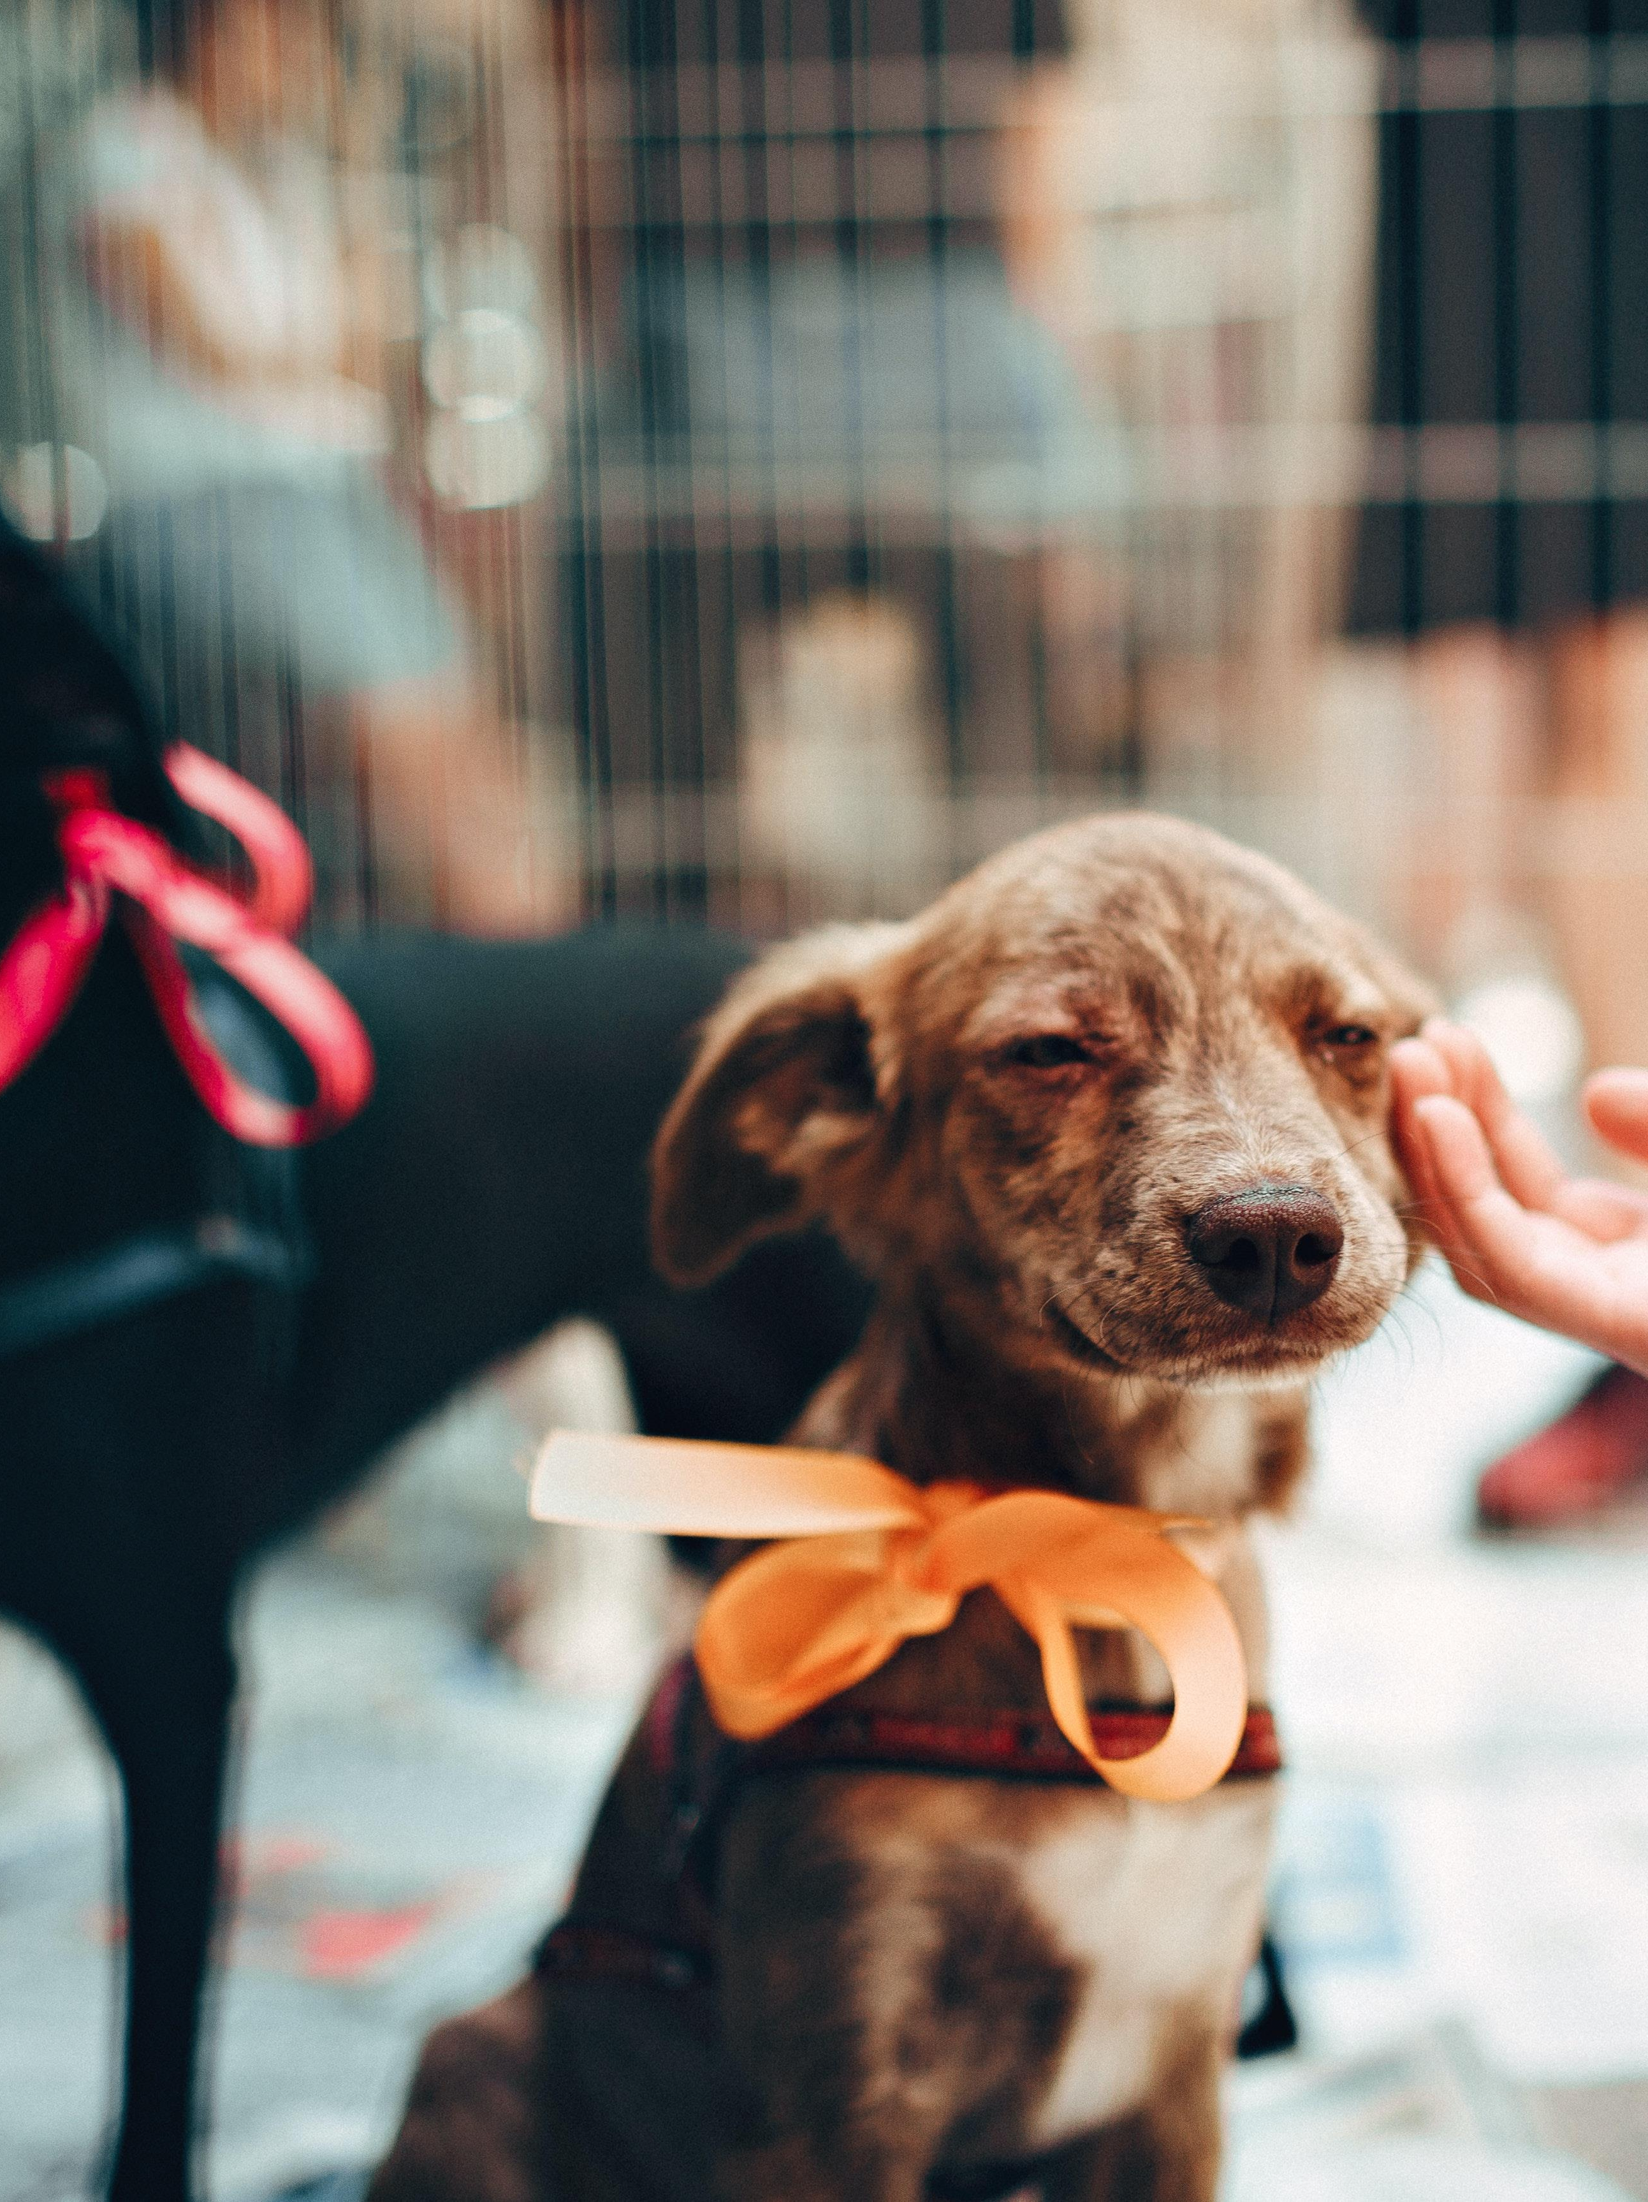
Lead with Compassion
The Leader must make strong statements
Be the person that makes people feel welcome and productive
Appreciate people out of the organizational mainstream and show them the same respect as you have for all the people you interface with.
Notes:
Lombardi

Slide 6
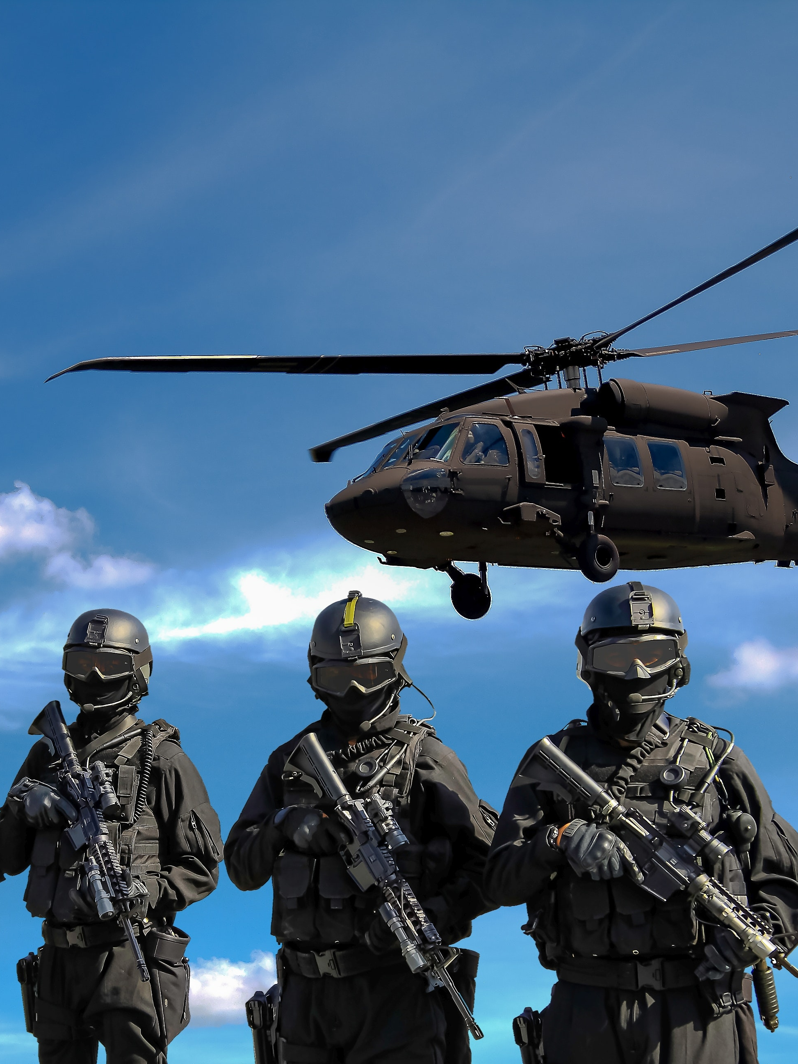
Each Team Member Must Understand
The livelihood of my teammates and the success of our business goals depend on me
my technical skill, tactical proficiency, and attention to detail.
Notes:
Taken from the Warrior Creed

Slide 7
End Team Standards

